Slide 1
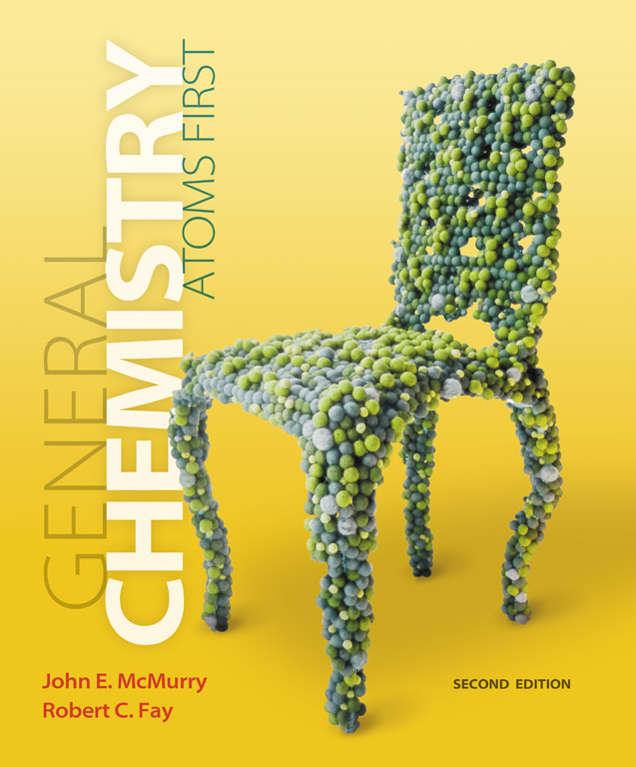
Clicker Questions
Chapter 1
The Structure and Stability of Atoms
Donald Linn
Indiana University–
Purdue University Fort Wayne
Fort Wayne, IN

Slide 2
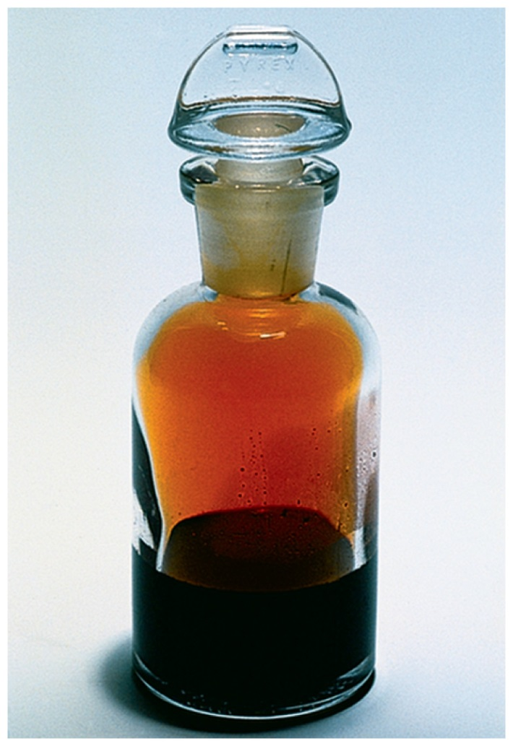
Which of the following is incorrect pertaining to nonmetals?
They typically have a low
boiling point.
b) They are found at the
right-hand side of the
periodic table.
c) They are good conductors of
electricity.
d) Some are colorful.
e) Many are found in the gas phase.
Notes:
Answer: c

Slide 3
Which of the following is incorrect pertaining to nonmetals?
They typically have a low
boiling point.
b) They are found at the
right-hand side of the
periodic table.
c) They are good conductors of
electricity.
d) Some are colorful.
e) Many are found in the gas phase.
Notes:
Answer: c

Slide 4
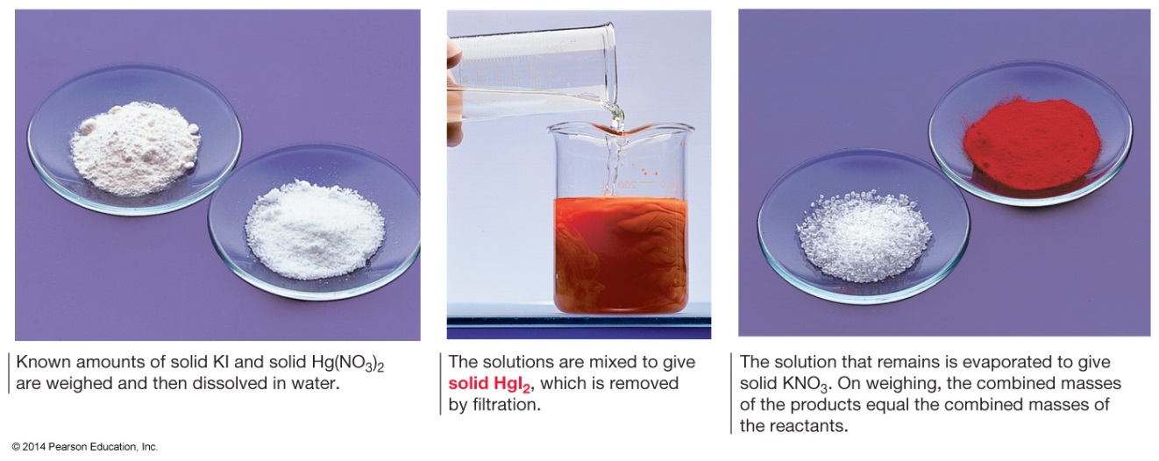
Two solutions contain 3.2 g and 3.3 g of Hg(NO₃)₂ and KI, respectively (which amounts to 10 mmol and 20 mmol, respectively). The two components were separated and dried. The mass of KNO₃ was determined to be 2.0 g (i.e., 20 mmol). What mass of HgI₂ was produced?
a) 9.0 g
b) 4.5 g
c) 4.0 g
d) 2.8 g
e) 1.4 g
Notes:
Answer: b

Slide 5
Two solutions contain 3.2 g and 3.3 g of Hg(NO₃)₂ and KI, respectively (which amounts to 10 mmol and 20 mmol, respectively). The two components were separated and dried. The mass of KNO₃ was determined to be 2.0 g (i.e., 20 mmol). What mass of HgI₂ was produced?
a) 9.0 g
b) 4.5 g
c) 4.0 g
d) 2.8 g
e) 1.4 g
Notes:
Answer: b

Slide 6
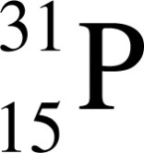
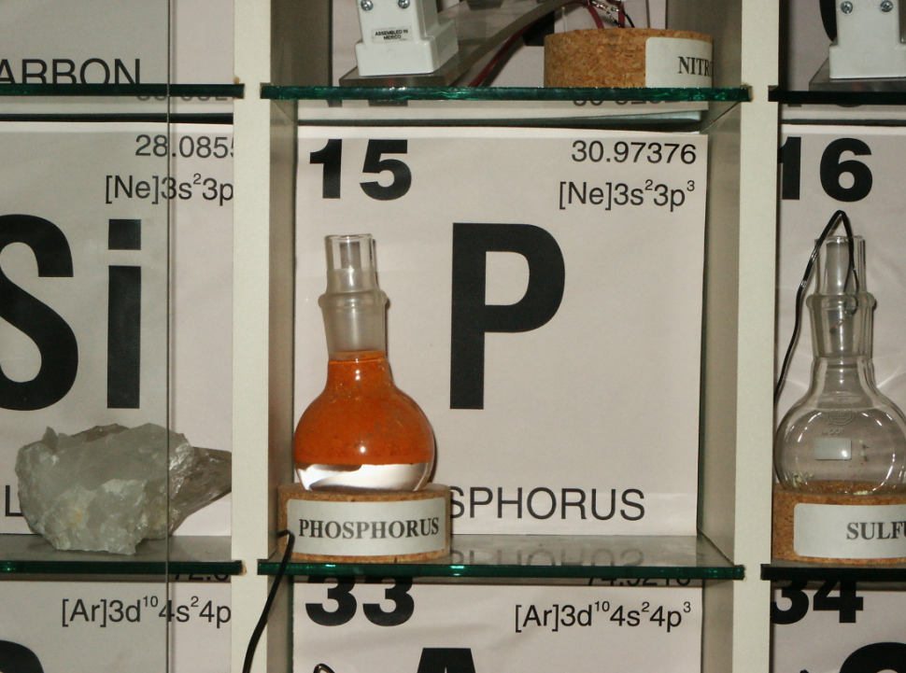
Red phosphorus is an allotrope of phosphorus that can be made by heating white phosphorus to temperatures above 240 ºC. The most common isotope of phosphorus can be represented by
How many protons,
electrons, and neutrons does
this isotope have?
a) 16, 16, 15
b) 15, 15, 1
c) 15, 15, 16
d) 16, 16, 31
e) 16, 16, 1
Notes:
Answer: c

Slide 7
Red phosphorus is an allotrope of phosphorus that can be made by heating white phosphorus to temperatures above 240 ºC. The most common isotope of phosphorus can be represented by
How many protons,
electrons, and neutrons does
this isotope have?
a) 16, 16, 15
b) 15, 15, 1
c) 15, 15, 16
d) 16, 16, 31
e) 16, 16, 1
Notes:
Answer: c

Slide 8

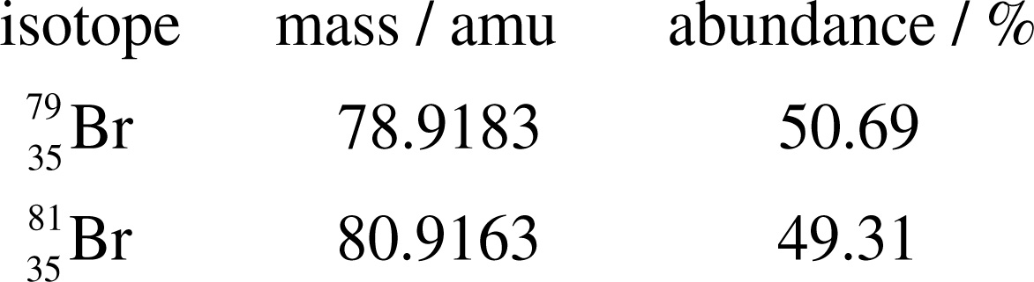
Bromine is a reddish-brown liquid. The atoms are composed of two isotopes with abundances and masses given below the figure. The average atomic mass of bromine is
a) 79.90
b) 79.92
c) 79.93
d) 79.99
e) 78.92
Notes:
Answer: a

Slide 9
Bromine is a reddish-brown liquid. The atoms are composed of two isotopes with abundances and masses given below the figure. The average atomic mass of bromine is
a) 79.90
b) 79.92
c) 79.93
d) 79.99
e) 78.92
Notes:
Answer: a

Slide 10
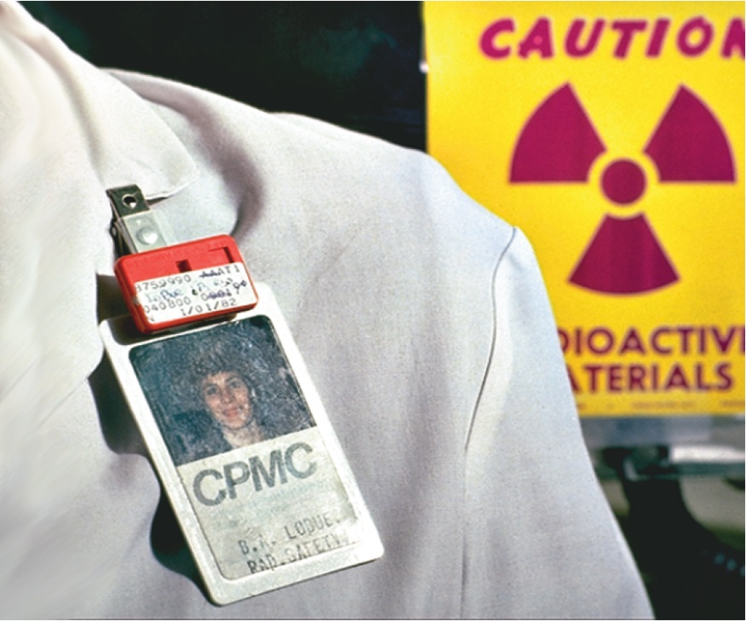
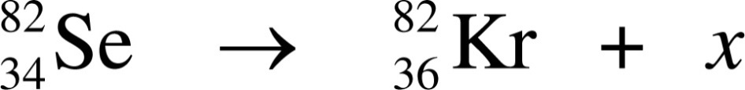





Selenium-82 decays to form krypton-82 according to the following incomplete nuclear reaction.
What is x in the above equation?
a)
d)
b)
e)
c)
Notes:
Answer: e

Slide 11

Selenium-82 decays to form krypton-82 according to the following incomplete nuclear reaction.
What is x in the above equation?
a)
d)
b)
e)
c)
Notes:
Answer: e

Slide 12
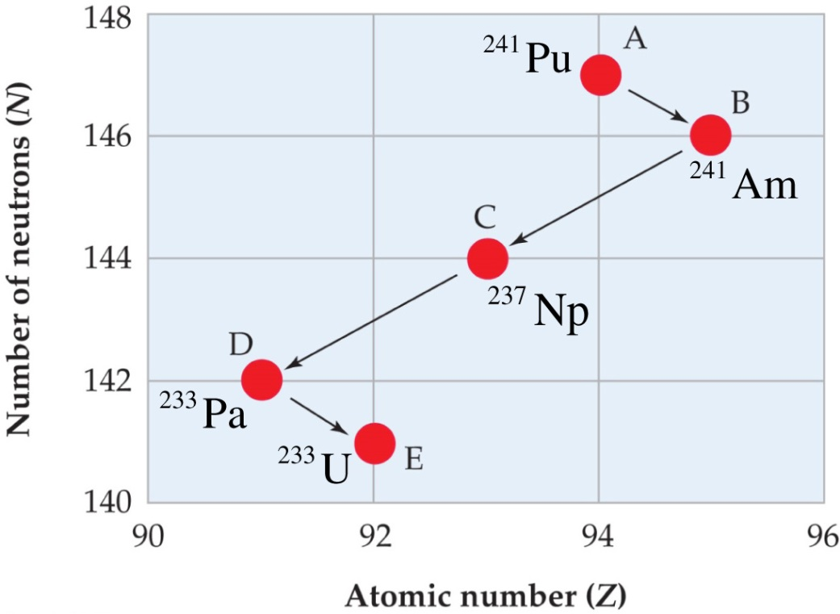
The type of radioactive process that ²⁴¹Pu and ²³³Pa undergo in the sequence to the right is called
a) fusion.
b) alpha emission.
c) gamma emission.
d) electron capture.
e) beta emission.
Notes:
Answer: e

Slide 13
The type of radioactive process that ²⁴¹Pu and ²³³Pa undergo in the sequence to the right is called
a) fusion.
b) alpha emission.
c) gamma emission.
d) electron capture.
e) beta emission.
Notes:
Answer: e

Slide 14
The so-called “lead pencils” are made of a form of carbon called graphite. A 2.0 cm pencil line is drawn and measured to be 300 mm wide. It is also estimated to be 4 nm thick. If the diameter of a carbon atom is 1.5 × 10^{–10} m, how many atoms are in this pencil line? [Hint: Assume that the carbon atoms occupy 74% of the space of the line.]
a) 2 × 10^{–5} atoms
b) 1 × 10⁵ atoms
c) 2 × 10¹³ atoms
d) 1 × 10¹⁹ atoms
e) 1 × 10²³ atoms
Notes:
Answer: d

Slide 15
The so-called “lead pencils” are made of a form of carbon called graphite. A 2.0 cm pencil line is drawn and measured to be 300 mm wide. It is also estimated to be 4 nm thick. If the diameter of a carbon atom is 1.5 × 10^{–10} m, how many atoms are in this pencil line? [Hint: Assume that the carbon atoms occupy 74% of the space of the line.]
a) 2 × 10^{–5} atoms
b) 1 × 10⁵ atoms
c) 2 × 10¹³ atoms
d) 1 × 10¹⁹ atoms
e) 1 × 10²³ atoms
Notes:
Answer: d

Slide 16
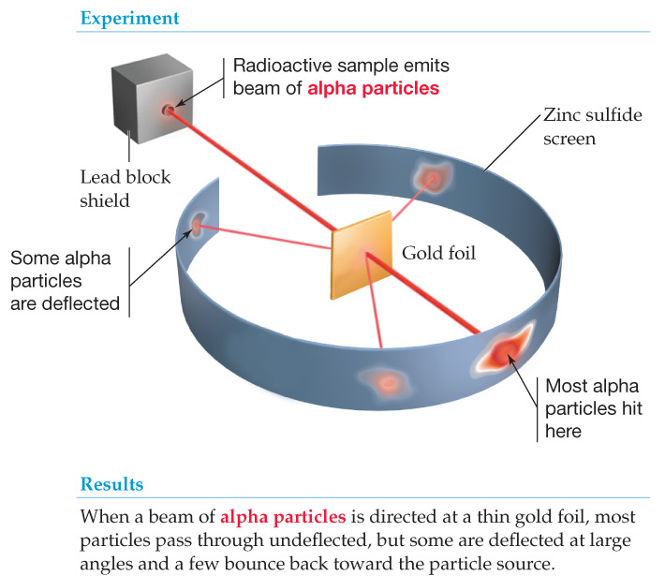
The gold foil used in Rutherford’s experiment was
0.0040 mm thick. Assuming gold to have a diameter
of 29 nm, how many layers of atoms did the alpha particles have to go through?
a) 1.4 × 10^{–4}
b) 7.3 × 10^{–3}
c) 140
d) 7300
e) 1.4 × 10⁵
Notes:
Answer: c

Slide 17
The gold foil used in Rutherford’s experiment was
0.0040 mm thick. Assuming gold to have a diameter
of 29 nm, how many layers of atoms did the alpha particles have to go through?
a) 1.4 × 10^{–4}
b) 7.3 × 10^{–3}
c) 140
d) 7300
e) 1.4 × 10⁵
Notes:
Answer: c

Slide 18
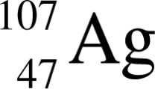
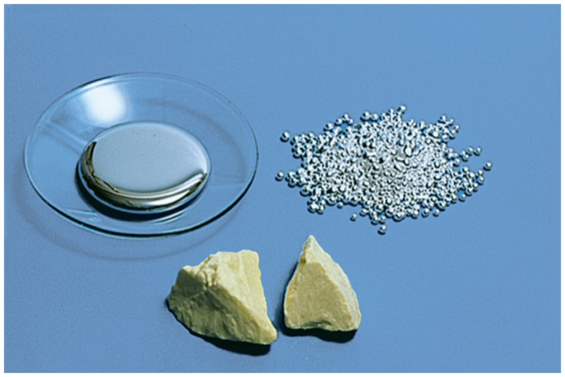
The most stable isotope of silver is given by
How many protons, neutrons, and electrons does it have?
p, n, e
a) 107, 47, 47
b) 60, 47, 60
c) 47, 47, 60
d) 47, 60, 47
e) 47, 107, 60
Notes:
Answer: d

Slide 19
The most stable isotope of silver is given by
How many protons, neutrons, and electrons does it have?
p, n, e
a) 107, 47, 47
b) 60, 47, 60
c) 47, 47, 60
d) 47, 60, 47
e) 47, 107, 60
Notes:
Answer: d

Slide 20


The average atomic mass of boron is 10.81. It is composed of two stable isotopes, and . The atomic mass of is 10.01, and it has an isotopic abundance of 20.00%. What is the atomic mass of ?
a) 14.01
b) 11.99
c) 11.01
d) 10.98
e) 10.89
Notes:
Answer: c

Slide 21
The average atomic mass of boron is 10.81. It is composed of two stable isotopes, and . The atomic mass of is 10.01, and it has an isotopic abundance of 20.00%. What is the atomic mass of ?
a) 14.01
b) 11.99
c) 11.01
d) 10.98
e) 10.89
Notes:
Answer: c

Slide 22
How many moles are in a 3.05 g sample of cesium? (molar mass Cs = 132.91 g mol^{–1})
a) 0.0229 moles
b) 0.0115 moles
c) 405 moles
d) 43.6 moles
e) 21.9 moles
Notes:
Answer: a

Slide 23
How many moles are in a 3.05 g sample of cesium? (molar mass Cs = 132.91 g mol^{–1})
a) 0.0229 moles
b) 0.0115 moles
c) 405 moles
d) 43.6 moles
e) 21.9 moles
Notes:
Answer: a

Slide 24






Americium is an alpha emitter that is used in smoke detectors. What does americium decay to?
a)
d)
b)
e)
c)
Notes:
Answer: b

Slide 25

Americium is an alpha emitter that is used in smoke detectors. What does americium decay to?
a)
d)
b)
e)
c)
Notes:
Answer: b

Slide 26
What is the mass of a single fluorine molecule, F₂?
a) 3.155 × 10^{–23} g
b) 6.310 × 10^{–23} g
c) 19.00 g
d) 38.00 g
e) None of the above
Notes:
Answer: b

Slide 27
What is the mass of a single fluorine molecule, F₂?
a) 3.155 × 10^{–23} g
b) 6.310 × 10^{–23} g
c) 19.00 g
d) 38.00 g
e) None of the above
Notes:
Answer: b

Slide 28
Which of the following has the smallest mass?
a) 3.50 × 1023 molecules of I₂
b) 85.0 g of Cl₂
c) 2.50 mol of F₂
d) 0.050 kg of Br₂
e) None of the above
Notes:
Answer: d

Slide 29
Which of the following has the smallest mass?
a) 3.50 × 1023 molecules of I₂
b) 85.0 g of Cl₂
c) 2.50 mol of F₂
d) 0.050 kg of Br₂
e) None of the above
Notes:
Answer: d

Slide 30
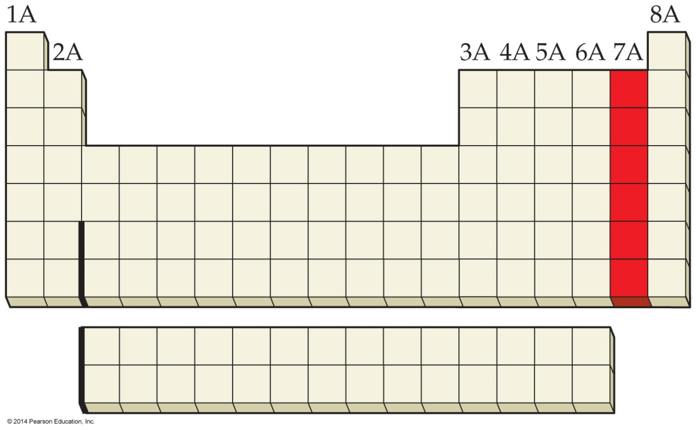
What group of elements does the shaded area in the following periodic table indicate?
a) Alkali metals
b) Alkaline earth metals
c) Halogens
d) Noble gases
e) None of the above
Notes:
Answer: c

Slide 31
What group of elements does the shaded area in the following periodic table indicate?
a) Alkali metals
b) Alkaline earth metals
c) Halogens
d) Noble gases
e) None of the above
Notes:
Answer: c

Slide 32
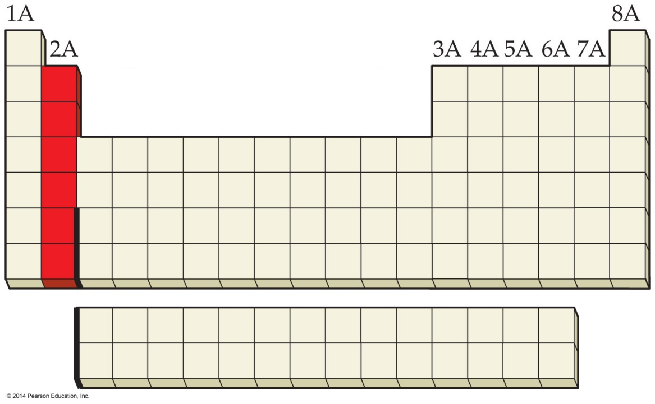
What group of elements does the shaded area in the following periodic table indicate?
a) Alkali metals
b) Alkaline earth metals
c) Halogens
d) Noble gases
e) None of the above
Notes:
Answer: b

Slide 33
What group of elements does the shaded area in the following periodic table indicate?
a) Alkali metals
b) Alkaline earth metals
c) Halogens
d) Noble gases
e) None of the above
Notes:
Answer: b

Slide 34
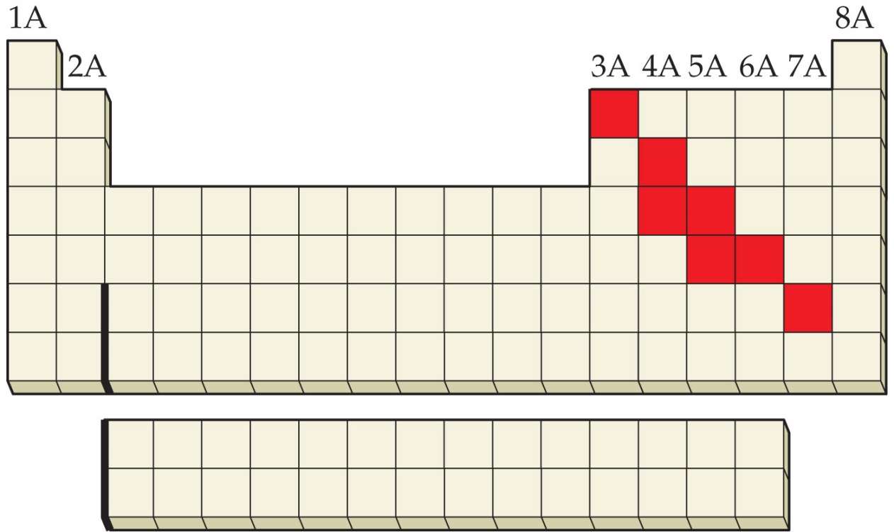
What group of elements does the shaded area in the following periodic table indicate?
a) Gases
b) Metals
c) Nonmetals
d) Semimetals
e) None of the above
Notes:
Answer: d

Slide 35
What group of elements does the shaded area in the following periodic table indicate?
a) Gases
b) Metals
c) Nonmetals
d) Semimetals
e) None of the above
Notes:
Answer: d

Slide 36
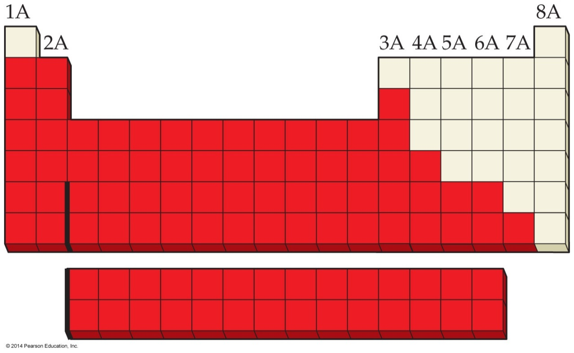
What group of elements does the shaded area in the following periodic table indicate?
a) Gases
b) Metals
c) Nonmetals
d) Semimetals
e) None of the above
Notes:
Answer: b

Slide 37
What group of elements does the shaded area in the following periodic table indicate?
a) Gases
b) Metals
c) Nonmetals
d) Semimetals
e) None of the above
Notes:
Answer: b

Slide 38
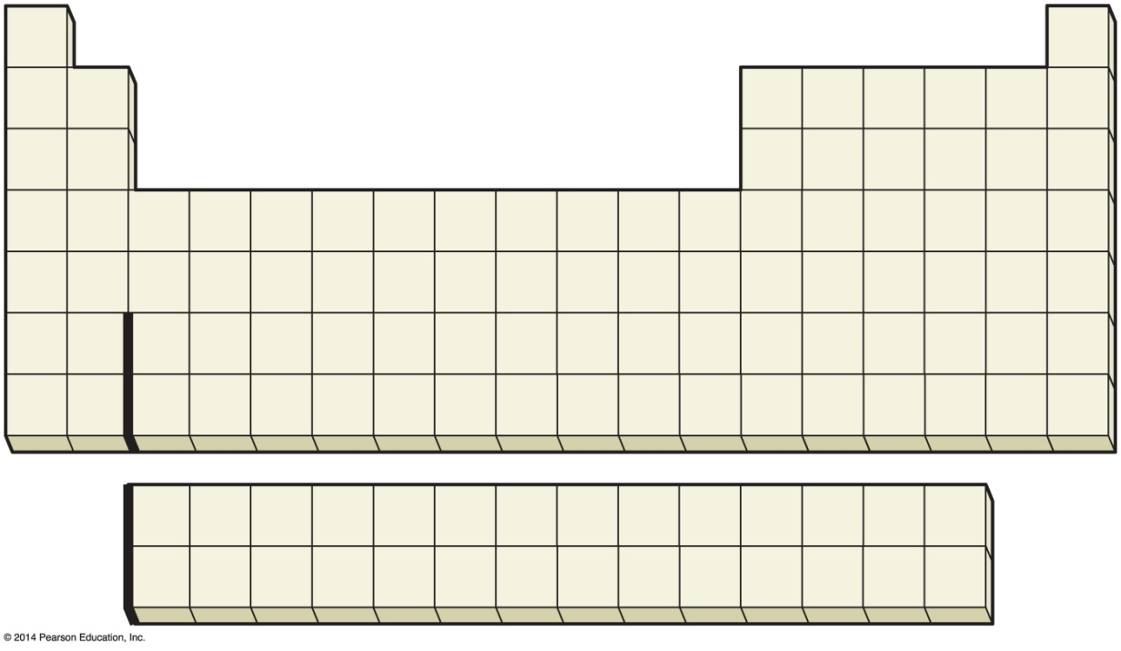
Which element is most chemically similar to the element indicated by the letter E in the following periodic table?
a) A
b) B
A
B
E
C
c) C
D
d) D
e) None of the above
Notes:
Answer: b

Slide 39
Which element is most chemically similar to the element indicated by the letter E in the following periodic table?
a) A
b) B
A
B
E
C
c) C
D
d) D
e) None of the above
Notes:
Answer: b

Slide 40
Which element has the chemical symbol, P?
a) Lead
b) Phosphorus
c) Platinum
d) Potassium
e) None of the above
Notes:
Answer: b

Slide 41
Which element has the chemical symbol, P?
a) Lead
b) Phosphorus
c) Platinum
d) Potassium
e) None of the above
Notes:
Answer: b

Slide 42
What is the chemical symbol for manganese?
a) Hg
b) Mg
c) Mn
d) Na
e) None of the above
Notes:
Answer: c

Slide 43
What is the chemical symbol for manganese?
a) Hg
b) Mg
c) Mn
d) Na
e) None of the above
Notes:
Answer: c

Slide 44
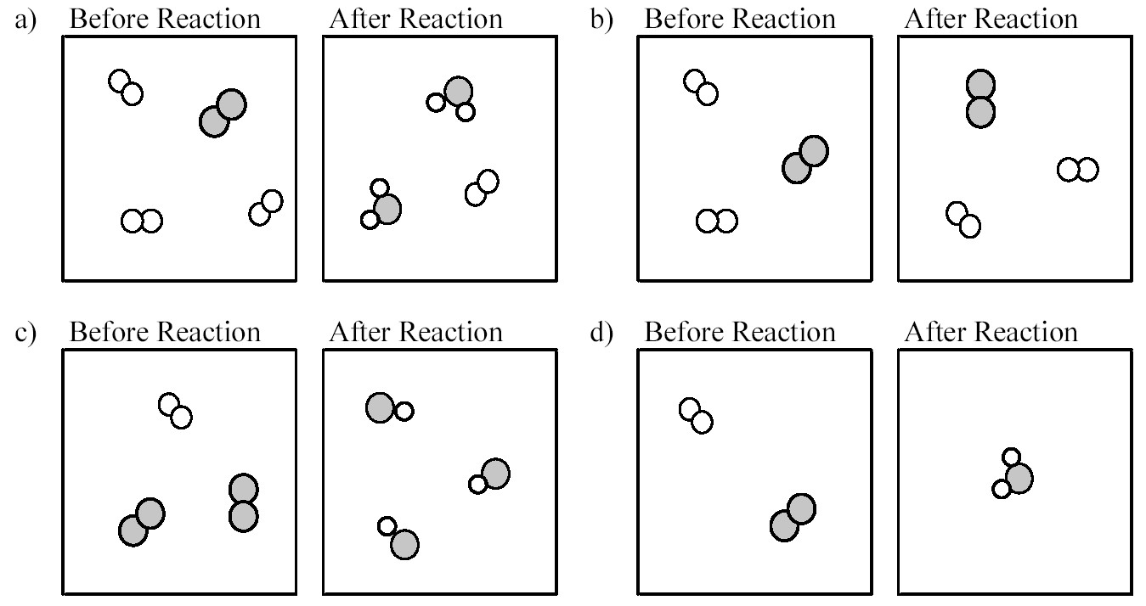
Which of the following drawings depicts a chemical reaction consistent with Dalton's atomic theory?
a) Drawing a)
d) Drawing d)
b) Drawing b)
e) None of the above
c) Drawing c)
Notes:
Answer: a

Slide 45
Which of the following drawings depicts a chemical reaction consistent with Dalton's atomic theory?
a) Drawing a)
d) Drawing d)
b) Drawing b)
e) None of the above
c) Drawing c)
Notes:
Answer: a

Slide 46
Methane and oxygen react to form carbon dioxide and water. What mass of water is formed if 3.2 g of methane reacts with 12.8 g of oxygen to produce 8.8 g of carbon dioxide?
a) 7.2 g
b) 8.8 g
c) 14.8 g
d) 16.0 g
e) None of the above
Notes:
Answer: a

Slide 47
Methane and oxygen react to form carbon dioxide and water. What mass of water is formed if 3.2 g of methane reacts with 12.8 g of oxygen to produce 8.8 g of carbon dioxide?
a) 7.2 g
b) 8.8 g
c) 14.8 g
d) 16.0 g
e) None of the above
Notes:
Answer: a

Slide 48
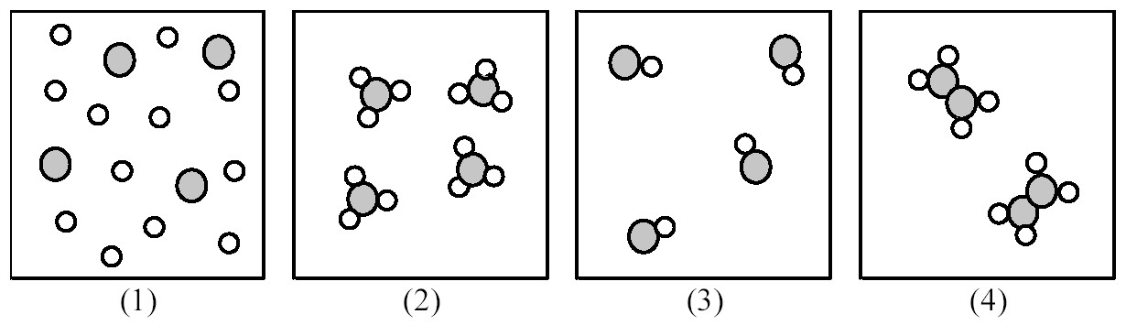
If shaded and unshaded spheres represent atoms of different elements, as shown in drawing (1), which combination of drawings (2)–(4) represent the law of multiple proportions?
a) Drawing (2) and (3)
d) Drawing (2), (3), and (4)
b) Drawing (2) and (4)
e) None of the above
c) Drawing (3) and (4)
Notes:
Answer: d

Slide 49
If shaded and unshaded spheres represent atoms of different elements, as shown in drawing (1), which combination of drawings (2)–(4) represent the law of multiple proportions?
a) Drawing (2) and (3)
d) Drawing (2), (3), and (4)
b) Drawing (2) and (4)
e) None of the above
c) Drawing (3) and (4)
Notes:
Answer: d

